Slide 1
Types of Reading
Dr. Kiran Magavi

Slide 2
“Reading is to the mind what exercise is to the body,” said English author Joseph Addison.
Just as you need exercise to build your physical strength, you need to read to build your mental muscles.
People read for a variety of reasons—to pass time, to seek answers, or to clear their heads.
Whatever their reasons for reading, it is a great way of exercising the brain and improving your communication skills.
Just as you have simple as well as specialized exercise routines and equipment, you also have different types of reading skills.
You can choose the right one depending on your objective.

Slide 3
Types of Reading
The four main types of reading techniques are the following:
Skimming.
Scanning.
Intensive.
Extensive.
Critical Reading ( later addition)

Slide 4
Skimming is sometimes referred to as gist reading where you’re trying to glance over the material to grasp the main idea.
The way you do this is to read the first and last paragraph and check for any dark headings.
Skimming may help in order to know what the text is about at its most basic level.
You might typically do this with a magazine or newspaper and would help you mentally and quickly shortlist those articles which you might consider for a deeper read.
You might typically skim to search for a name in a telephone directory.
You can reach a speed count of even 700 words per minute if you train yourself well in this particular method.

Slide 5
Scanning
Scanning involves getting your eyes to quickly scuttle across sentence and is used to get just a simple piece of information. You’ll be searching for specific words or phrases that will give you more information and answer questions you may have.
Interestingly, research has concluded that reading off a computer screen actually inhibits the pathways to effective scanning and thus, reading of paper is far more conducive to speedy comprehension of texts.
Something students sometimes do not give enough importance to is illustrations.
These should be included in your scanning. Pay special attention to the introduction and the conclusion.

Slide 6
Intensive Reading
You need to have your aims clear in mind when undertaking intensive reading.
Remember this is going to be far more time consuming than scanning or skimming.
If you need to list the chronology of events in a long passage, you will need to read it intensively.
This type of reading has indeed beneficial to language learners as it helps them understand vocabulary by deducing the meaning of words in context.
It moreover, helps with retention of information for long periods of time and knowledge resulting from intensive reading persists in your long term memory.
This is one reason why reading huge amounts of information just before an exam does not work very well.
Students tend to do this, and they undertake neither type of reading process effectively, especially neglecting intensive reading.
They may remember the answers in an exam but will likely forget everything soon afterwards.

Slide 7
Extensive reading
Extensive reading involves reading for pleasure.
Because there is an element of enjoyment in extensive reading it is unlikely that students will undertake extensive reading of a text they do not like.
It also requires a fluid decoding and assimilation of the text and content in front of you.
If the text is difficult and you stop every few minutes to figure out what is being said or to look up new words in the dictionary, you are breaking your concentration and diverting your thoughts.

Slide 8
Critical Reading
Among the different types of reading strategies, critical reading has a special place.
Here, the facts and information are tested for accuracy. You take a look at the ideas mentioned and analyze them until you reach a conclusion.
You would have to apply your critical faculties when using this method.
Critical reading is often used when reading the news on social media, watching controversial advertisements, or reading periodicals.

Slide 9
Various types of reading lead to different outcomes.
Choosing the right one can be instrumental in furthering your goals.
Further, diversifying your reading habits to include different types of reading will enable you to become a better writer and speaker.
Improving your communication skills will enable you to convey your ideas with precision and clarity.
It’s not always easy to get your point across.
However, reading gives you the power to understand multiple perspectives.
Building a reading habit can be effective in the short and long run.

Slide 10
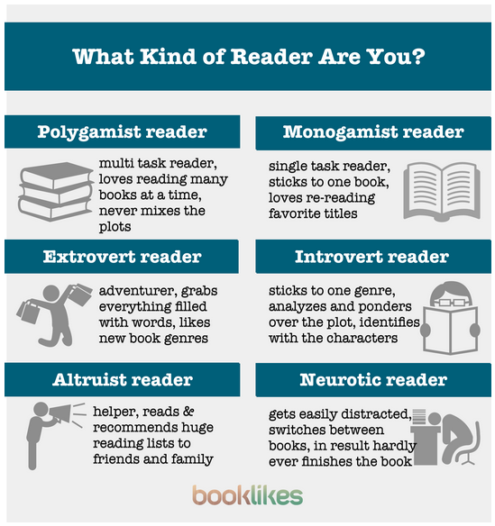
Some fun facts

